Slide 1
Module 4: Make canvas apps with Power Apps

Slide 2
Canvas Power Apps
Power Apps studio
Canvas app capabilities
User experience

Slide 3
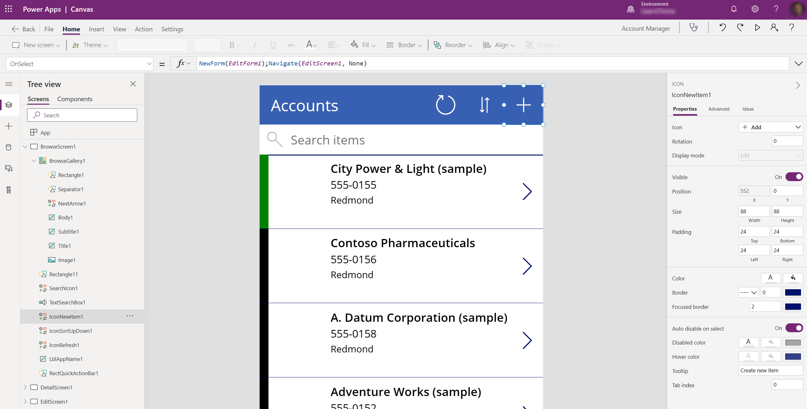
Power Apps Studio
Power Apps Studio is where you develop canvas apps

Slide 4

Demo

Slide 5
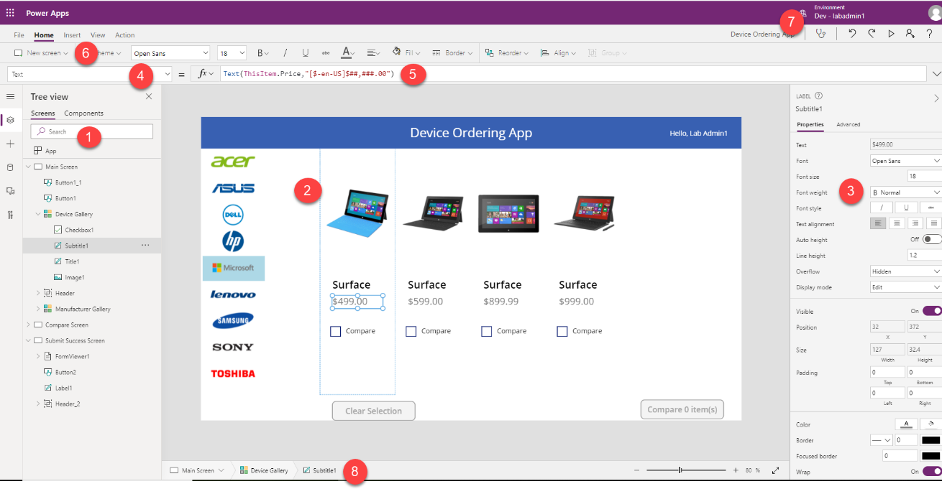
Explore the app designer experience
Left navigation bar
Middle pane
Right-hand pane
Property
Formula bar
Ribbon
Additional items
Breadcrumbs

Slide 6
Ways to start a Power Apps canvas app
From a template
From a data source
From a blank canvas

Slide 7
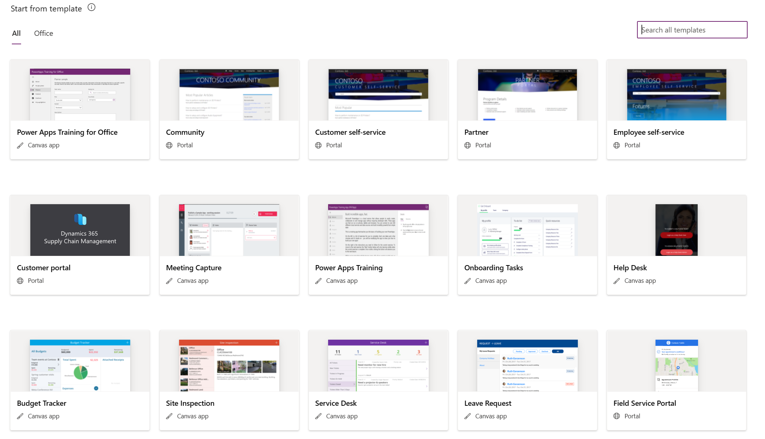
Create an app from a template

Slide 8
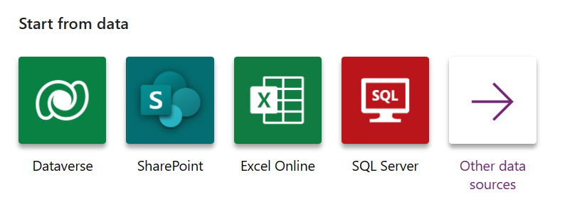
Create an app from a data source

Slide 9
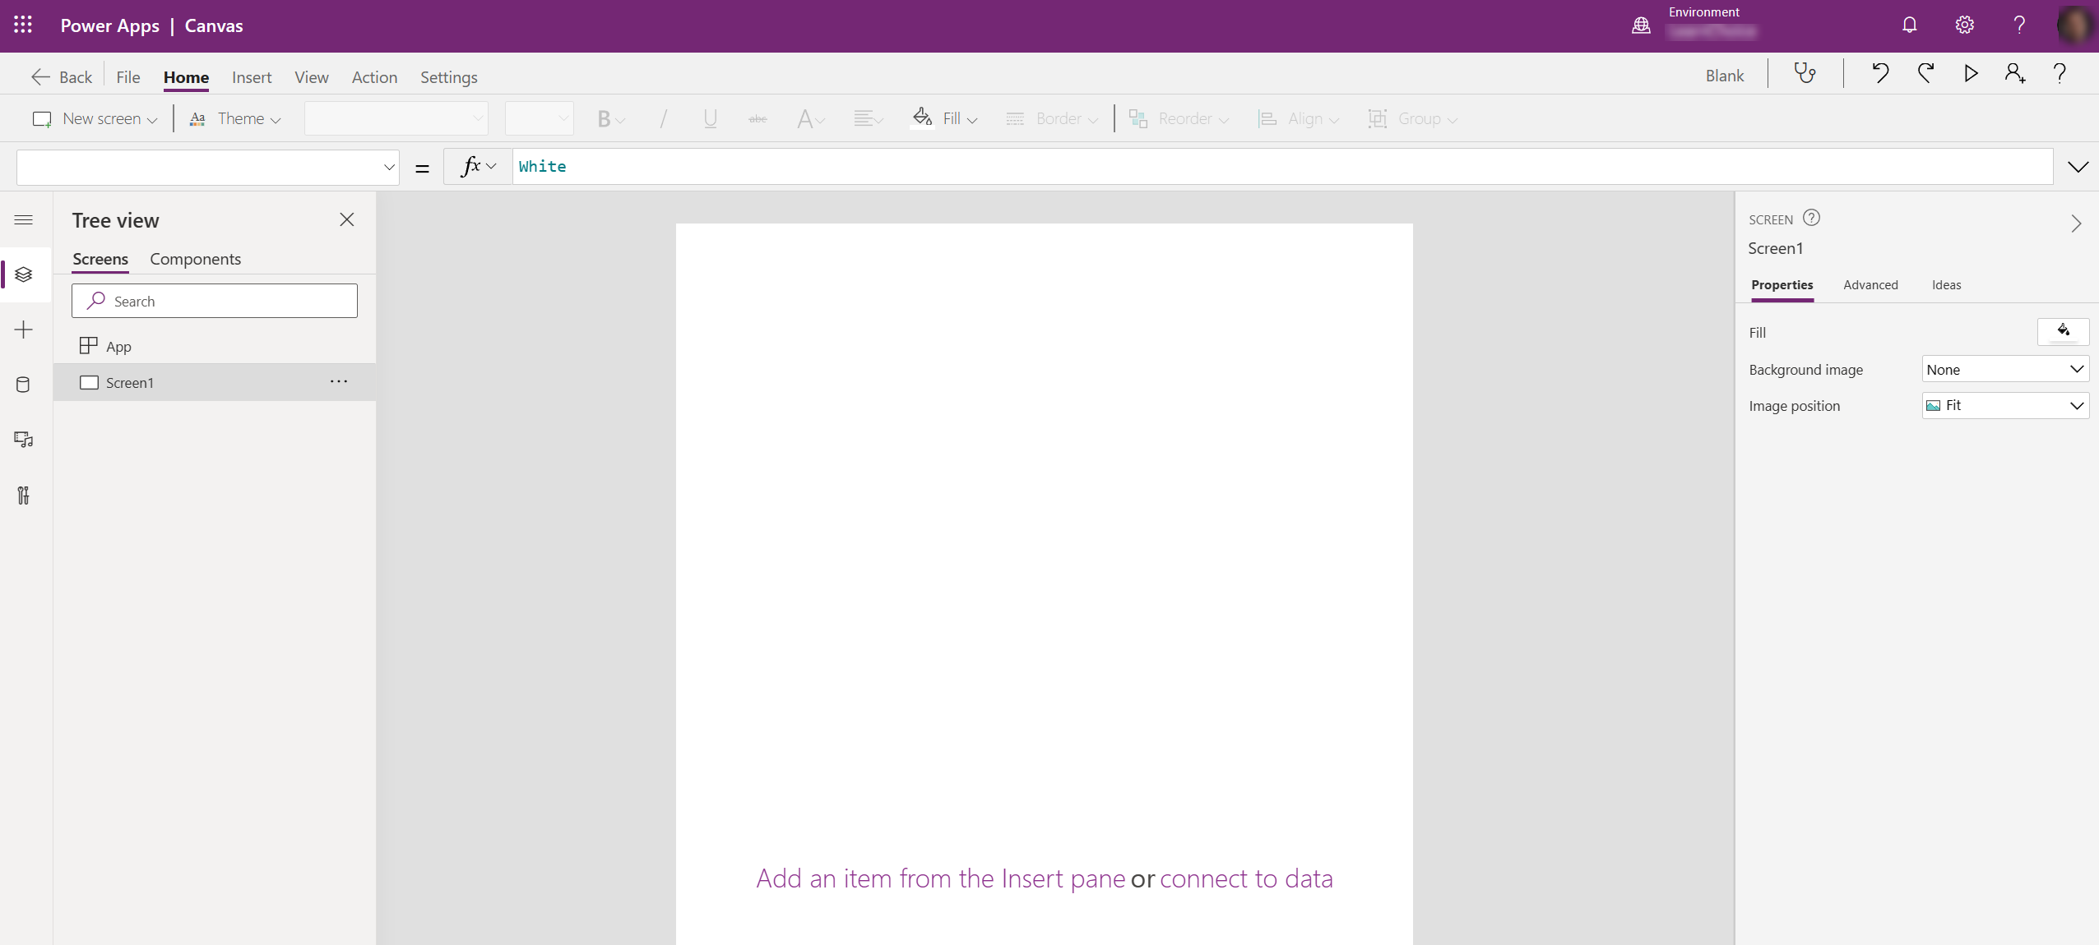
Build from a blank canvas

Slide 10
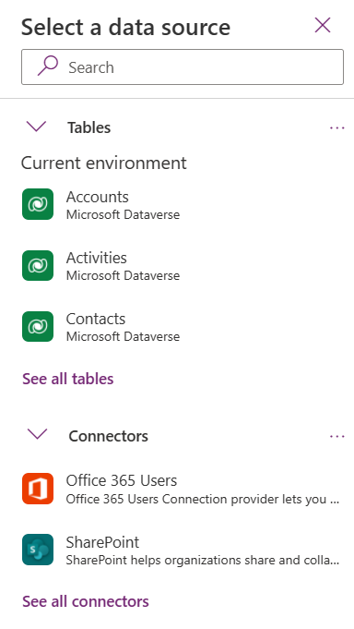
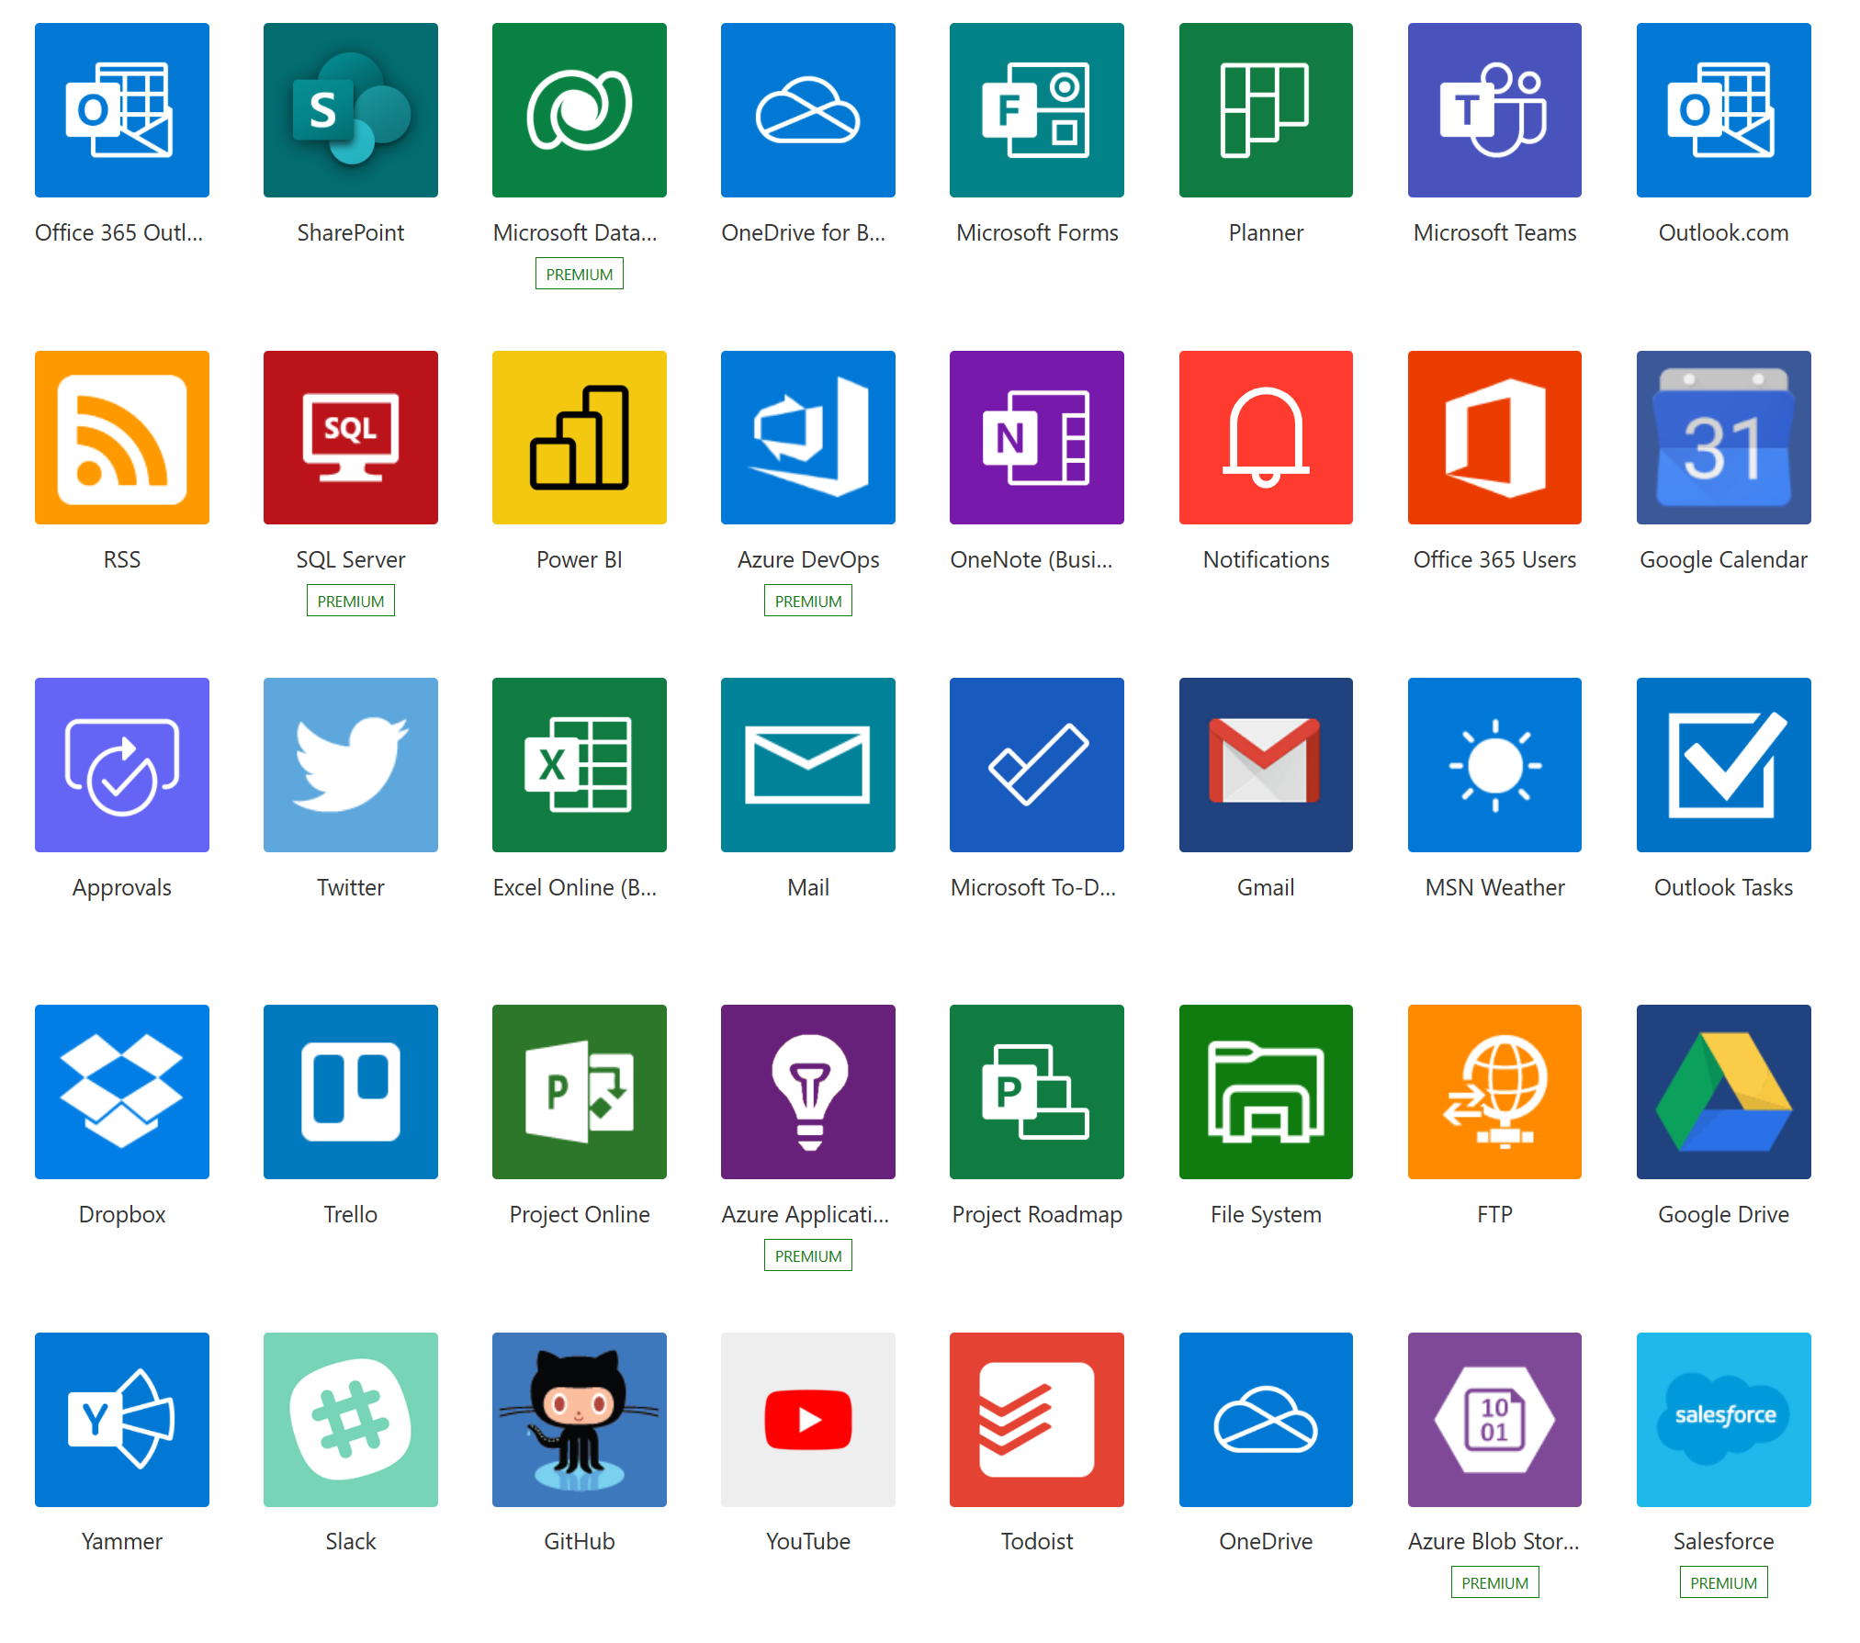
Data sources, connections, and gateways

Slide 11
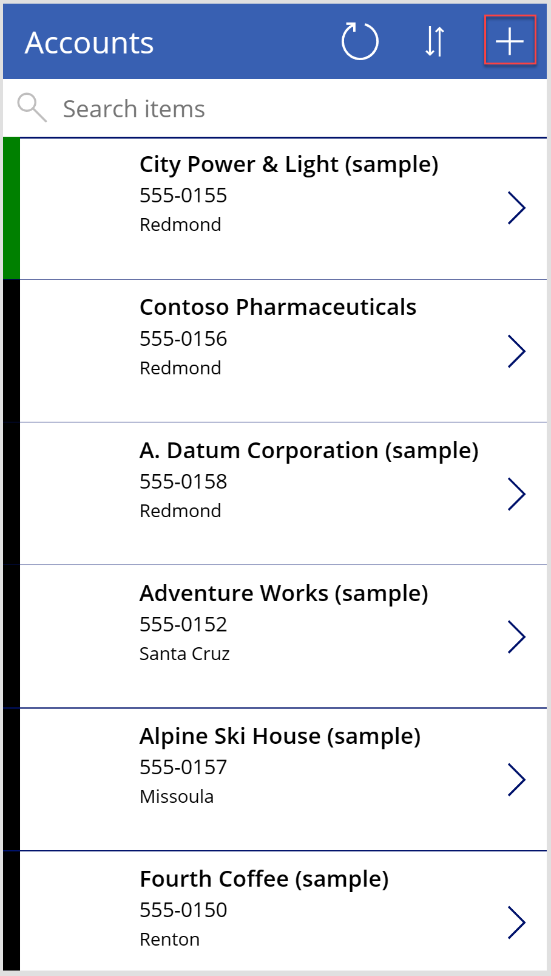
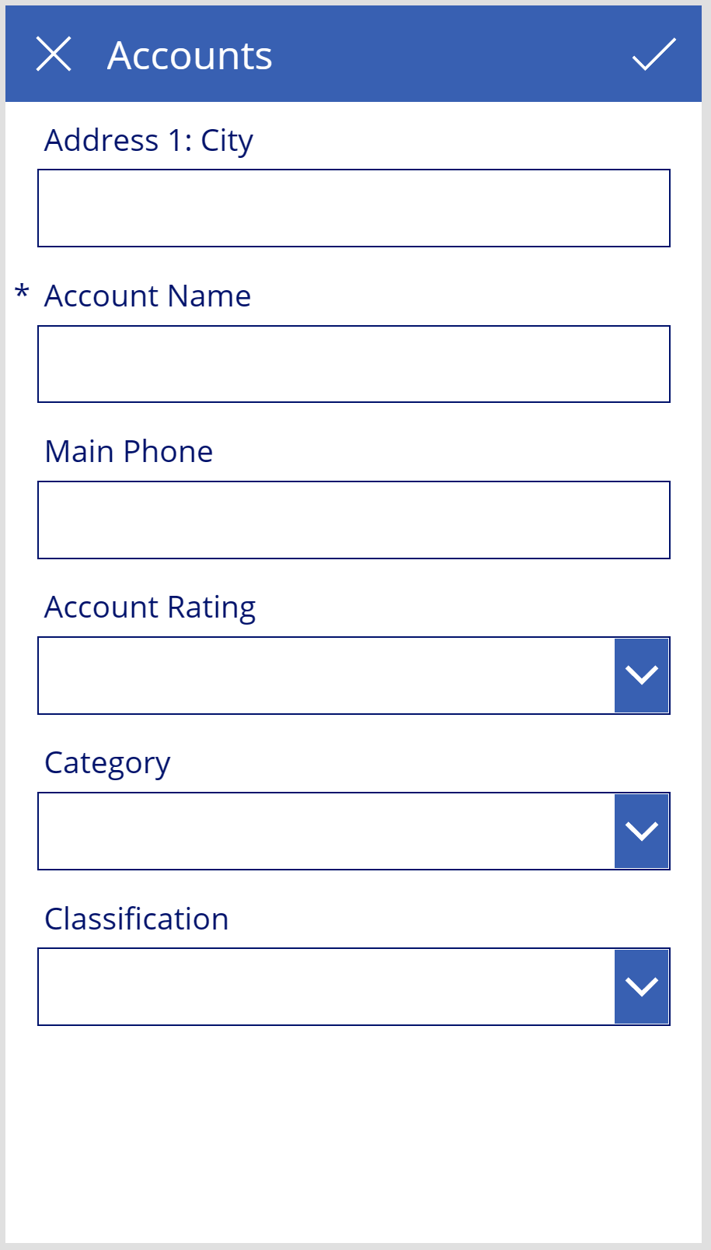
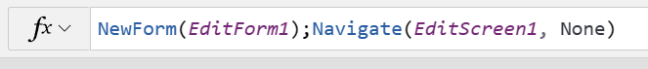
Canvas app basics
Screen 1
Navigate
Screen 2

Slide 12
Power Fx formulas
Configure your app with formulas that not only calculate values and perform other tasks (as they do in Excel) but also respond to user input
For example, you build a formula to determine how your app responds when users select a button, adjust a slider, or provide other input.
https://docs.microsoft.com/en-us/powerapps/maker/canvas-apps/formula-reference

Slide 13
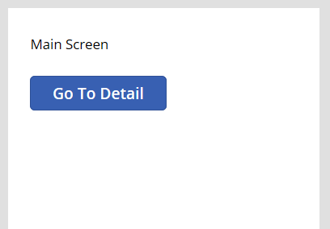
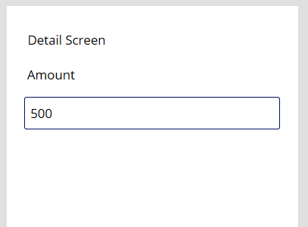
Screen Navigation
Navigate(ScreenName, ScreenTransition.*) – go to specific screen
Back() – Go to previous screen
Using Back() to return to the prior page is more flexible
Pass context from one screen to the next

Slide 14
Controls in Power Apps
UI elements that produces an action or shows information
Common controls include:
Galleries:
Layout containers that hold a set of controls that show rows from a data source
Forms:
Show details about your data and let you create and edit rows
Media:
Lets you add background images, include a camera button, a barcode reader, and more
Charts:
Add charts so that users can perform instant analysis while they’re on the road

Slide 15
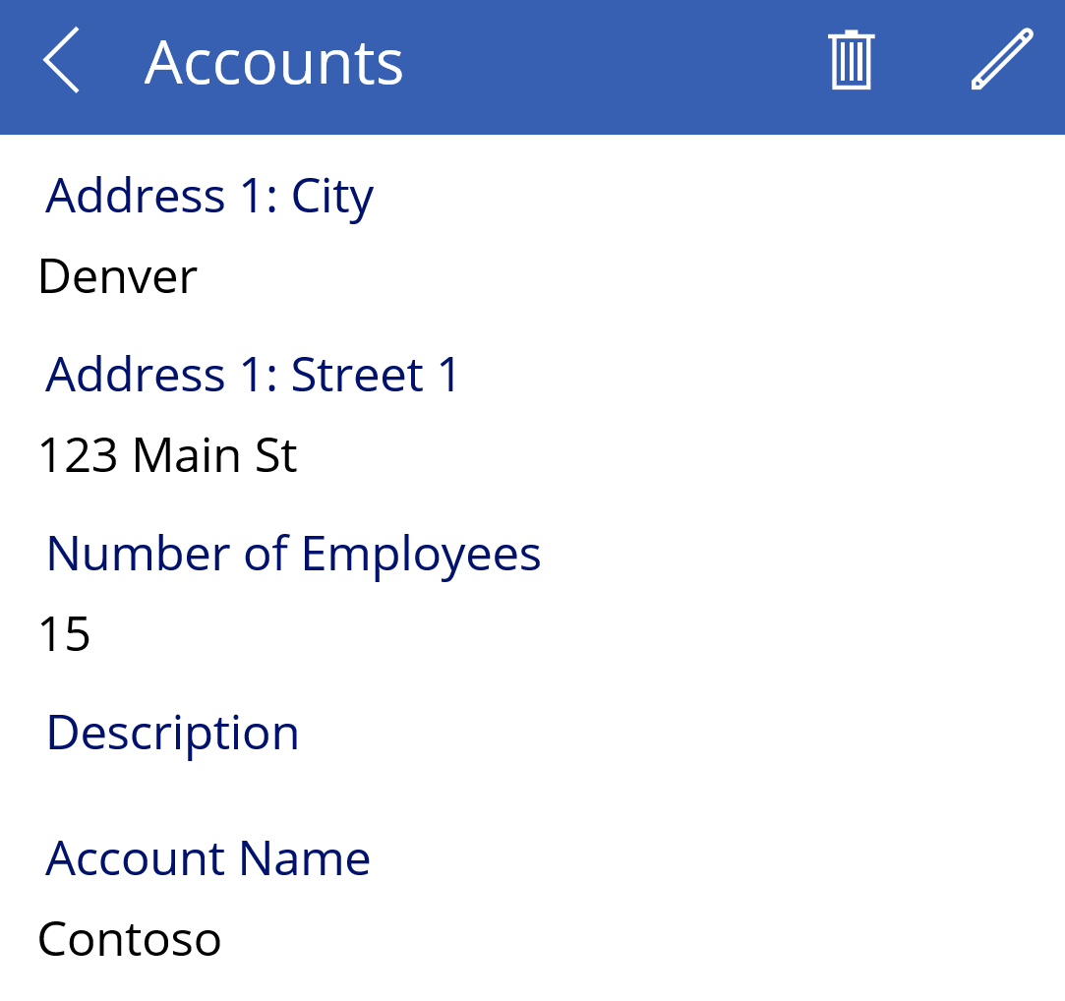
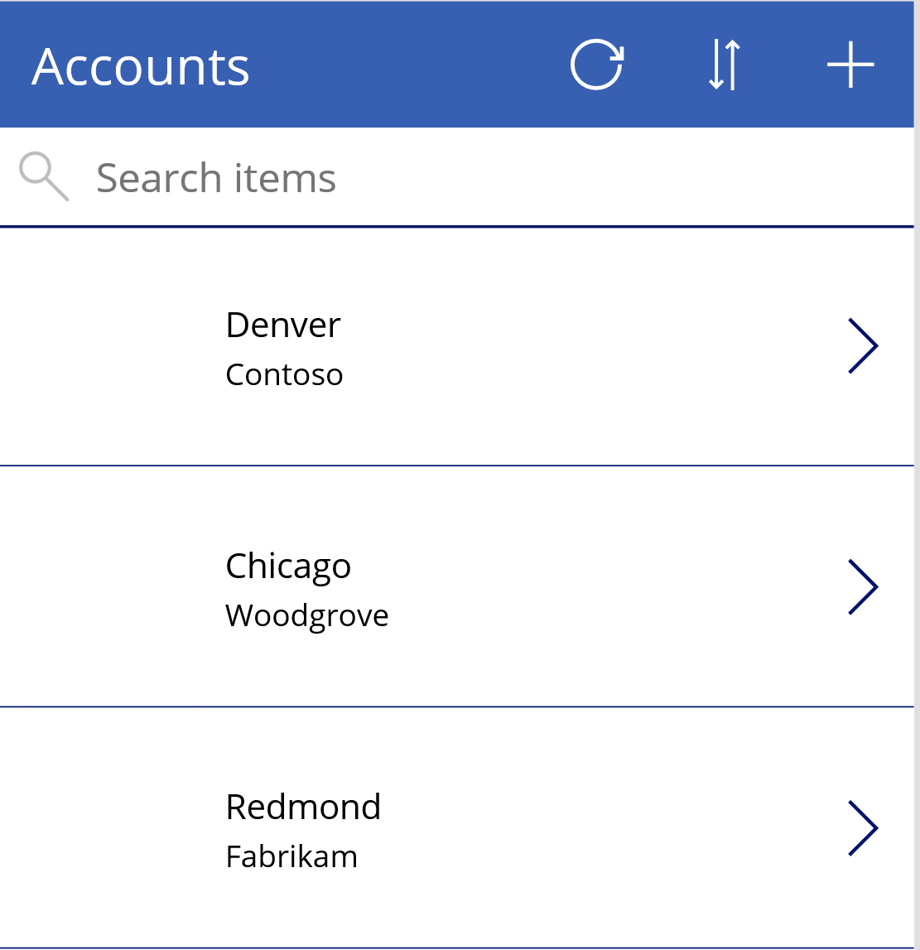
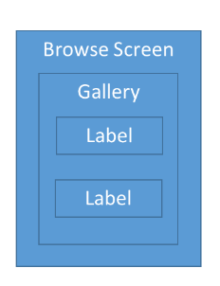
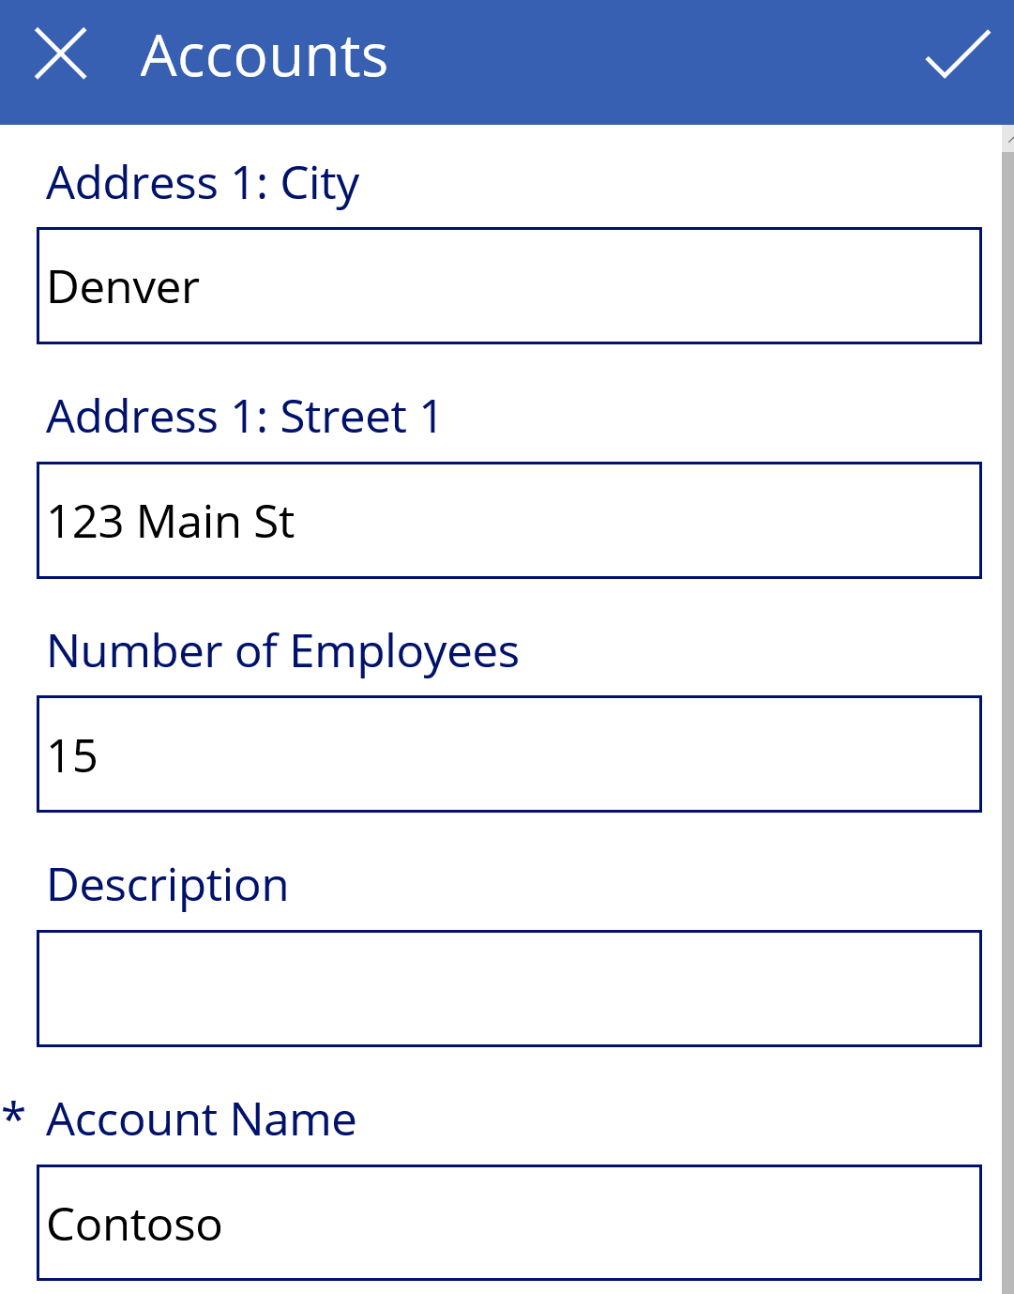
Working with Data (Galleries and Forms)
Display Form
Edit Form

Slide 16
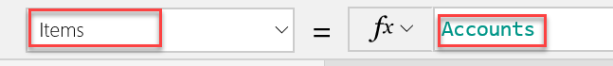
Connecting the Gallery to Data
No Searching or Sorting
Searching

Slide 17
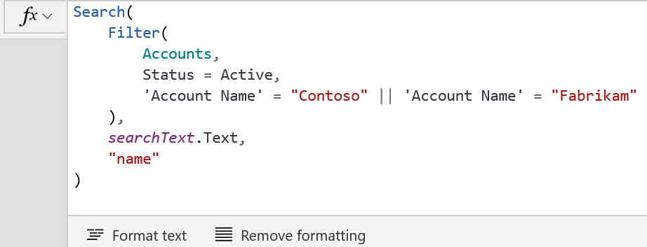
Filtering Data
Filter function applies the formula to each record
Can include =,<>,<,>=,<=,&&,|| and in operators

Slide 18
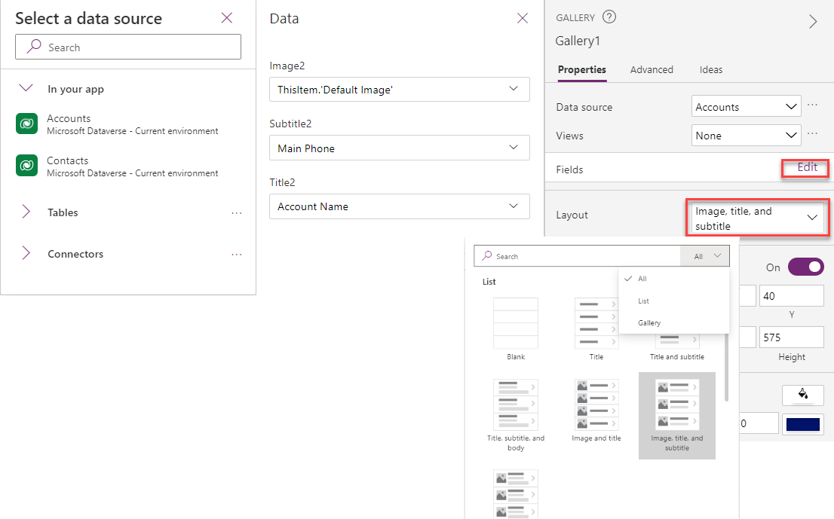
Working with Galleries

Slide 19
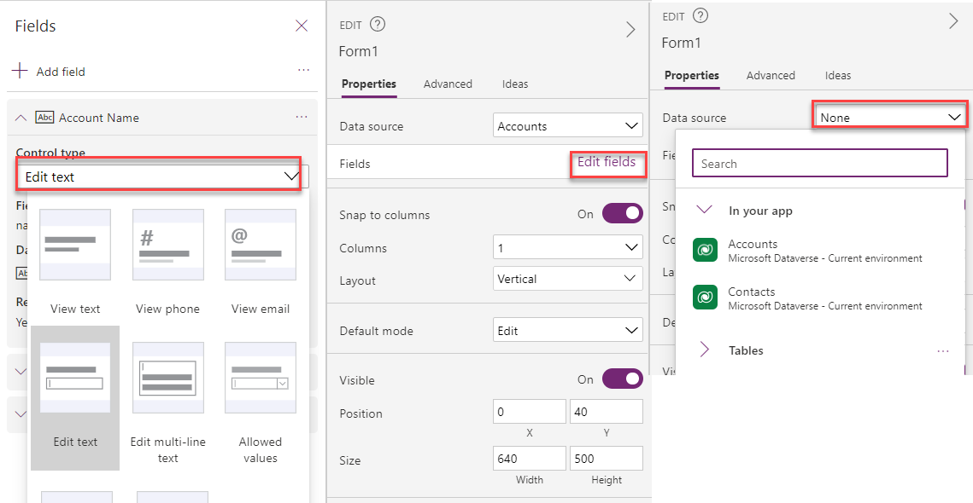
Forms

Slide 20
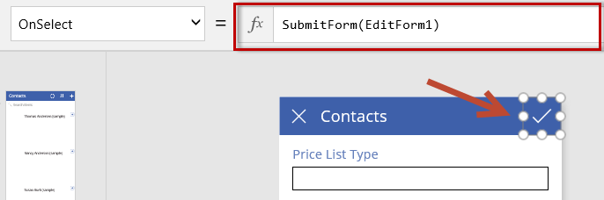
Working with forms
SubmitForm – causes save to happen on new/changed data
NewForm – sets a form up for creating a new record
EditForm – sets the form into edit mode
ResetForm – reset the form the initial state e.g. cancel edits

Slide 21
Entering and displaying data with text controls
Text controls are used for all kinds of purposes, such as displaying text, numbers, dates, and calculating currency
Label:
A label shows data that you specify as a literal string of text, which appears exactly the way you type it, or as a formula that evaluates to a string of text
Text input:
A box in which the user can type text, numbers, and other data
HTML text:
An HTML text control not only shows plain text and numbers but also converts HTML tags, such as non-breaking spaces
Rich text editor:
The rich text editor control provides the app user a WYSIWYG editing area for formatting text
Pen input:
A control in which the user can draw, erase, and highlight areas of an image

Slide 22
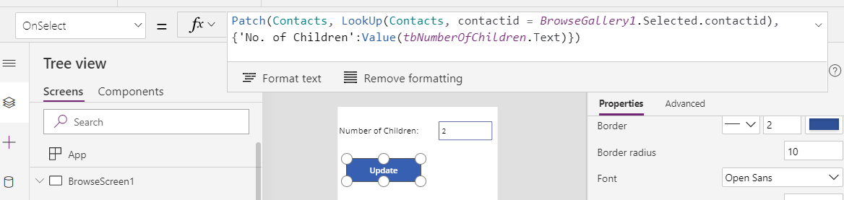
Creating or updating with patch
Can modify or create one or more records

Slide 23
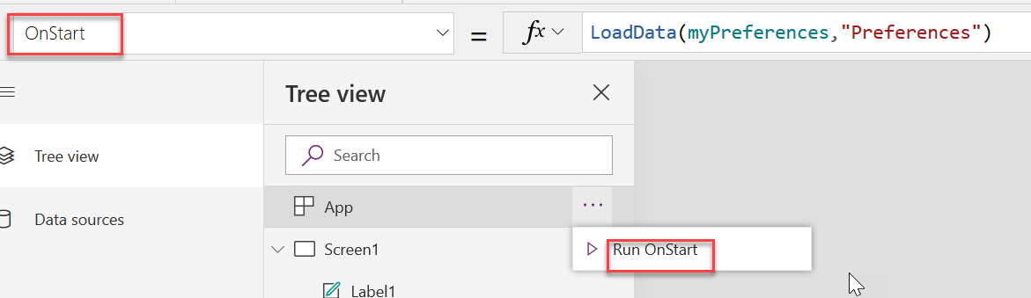
OnStart
Formula runs when application starts execution
Set as a property of the first screen
Not actually a property of the screen, instead a property of the app
Just a convenient place for us to put formula editing temporarily
Useful for preloading data, starting on a particular screen, and other similar scenarios

Slide 24
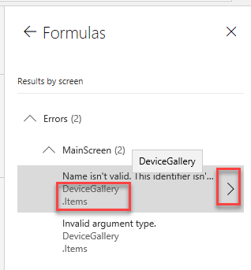
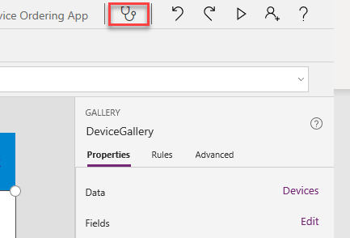
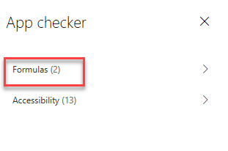
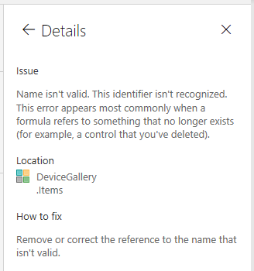
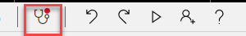
Using App Checker
No Errors
Errors Detected

Slide 25
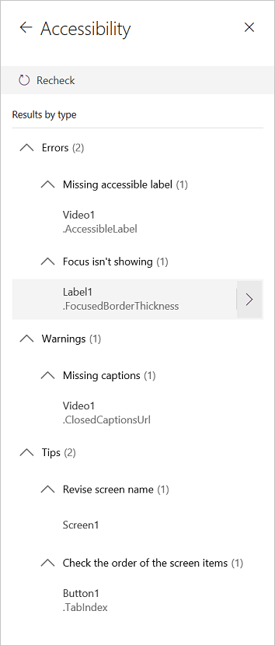
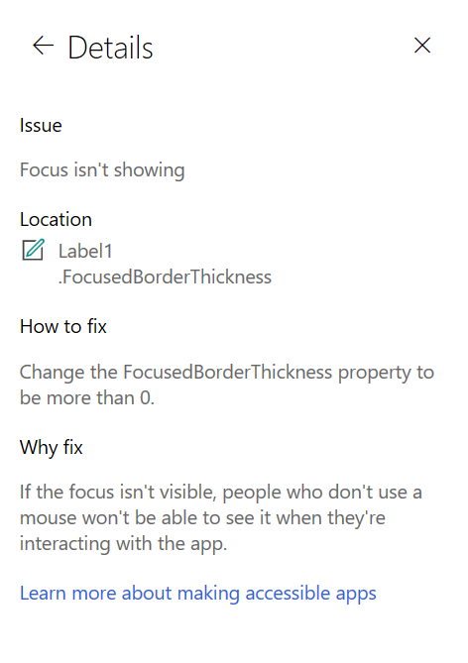
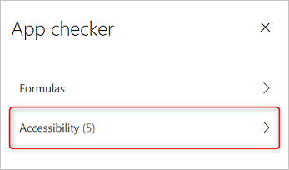
App Checker - Accessibility
This tool not only finds potential accessibility issues but also explains why each might be a potential problem
aka.ms/powerappsaccessibilityguidelines

Slide 26
Demo

Slide 27

How many screens should a canvas app have?

Slide 28
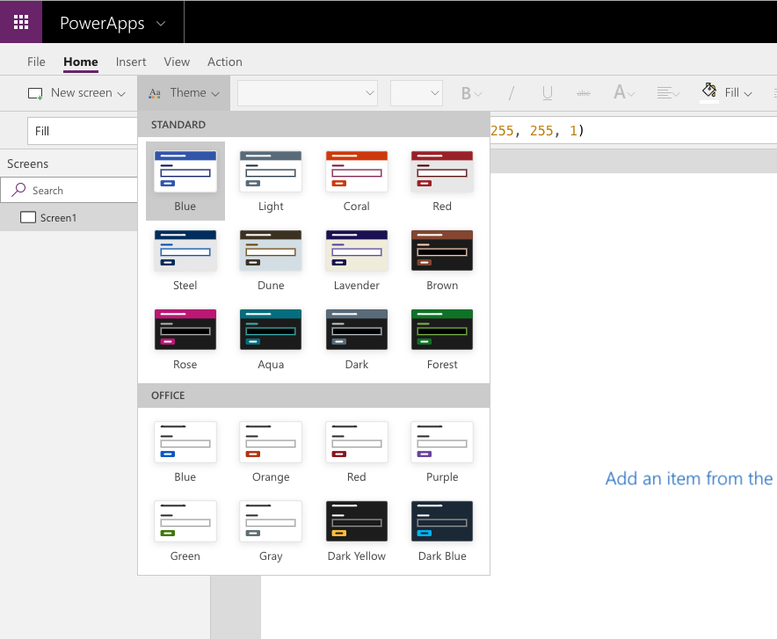
Use themes to quickly change the appearance of your app

Slide 29
Typical properties
These properties are in effect when the user is not interacting with the control.
BorderColor - The color of a control's border.
BorderStyle - Determines whether a control's border is solid, dashed, dotted, or none.
Color - The color of text in a control.
Fill - The background color of a control

Slide 30
Disabled properties
These properties are in effect when the control is disabled.
DisabledColor - The color of text in a control if its DisplayMode property is set to Disabled.
DisabledFill - The background color of a control if its DisplayMode property is set to Disabled.

Slide 31
Hover properties
These properties are in effect when the user hovers over the control with a mouse.
HoverColor - The color of the text in a control when the user keeps the mouse pointer on it.
HoverFill - The background color of a control when the user keeps the mouse pointer on it.

Slide 32
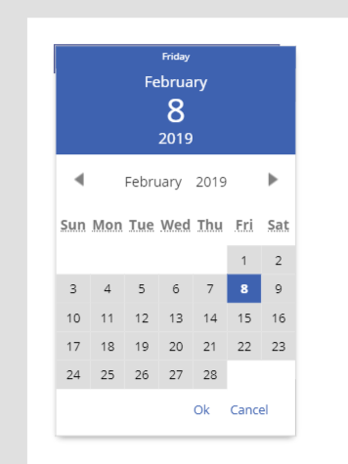
Some color settings are only controlled by the theme
There are certain aspects of controls that cannot be altered and are specific to the theme that you select.
In Power Apps Studio, add the Date picker control.
Put the app in preview mode and select the control so that it opens.
The color at the top of the Date picker control is specific to the theme, meaning there isn't a control property you can change to set the color manually. To change the color of that background you would have to select a different theme.

Slide 33
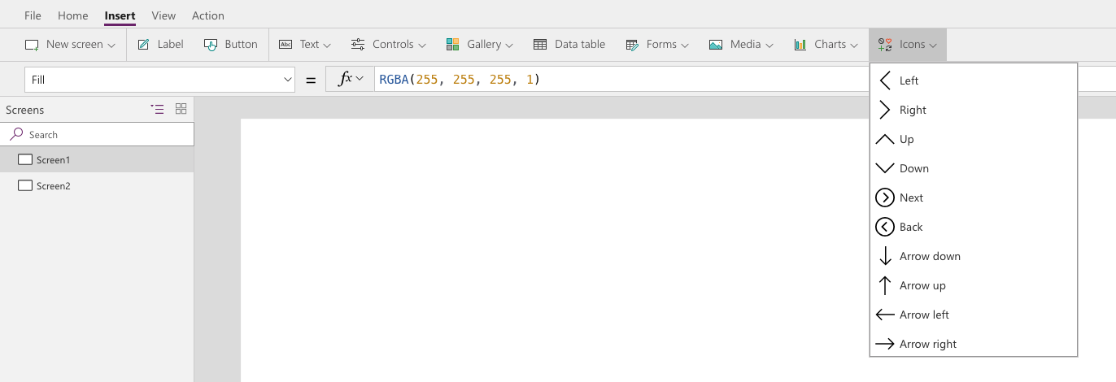
Icons
When designing your app, utilize shapes and icon controls when possible to enhance the user experience of your app.

Slide 34
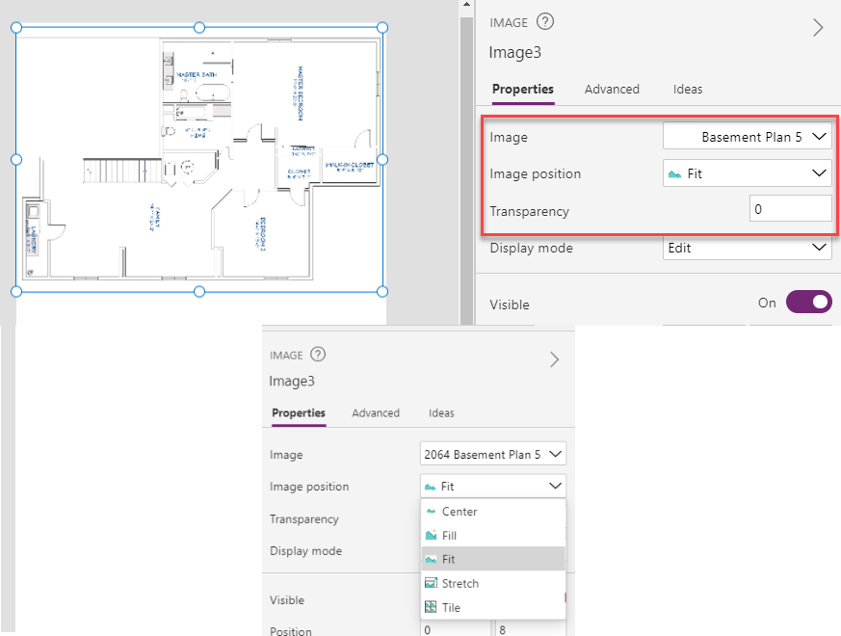
Including images
Image - The name of the image that appears in an image
Image Position - The position (Fill, Fit, Stretch, Tile, or Center) of the image in a screen or a control if it isn't the same size as the image.
Transparency - The degree to which the controls behind an image remain visible.

Slide 35
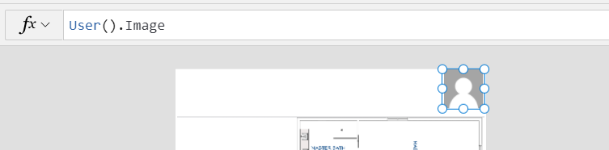
Personalization
In Power Apps, you can show information about the current user with the User() function.
On the Insert tab, click or tap Media, and then click or tap Image.
Set the Image property to this formula: User().Image
On the Insert tab, click or tap Text, and then click or tap Label:
Set the Text property to this formula: User().FullName
Move the label so it's below the image control.
Add another label, and set its Text property to this formula: User().Email
Move the label so it's below the first label:
Property | Description
User().Email | Email address of the current user.
User().FullName | Full name of the current user, including first and last name.
User().Image | Image of the current user. This will be an image URL of the form "blob:identifier".

Slide 36
Module 4 practice labs
Lab 4.1: Build a canvas app
Lab 4.2: Work with data and services
Lab 4.3: User experience

Slide 37
Summary
Canvas apps give you pixel precision to build smart apps using low code, or no code.
Apps are available across devices and platforms.
Connectors and Power Automate expand the options.

Slide 38
Closing slide

